Slide 1
IMMUNITY &
IMMUNOLOGY

Slide 2
Examples of Immune Responses:
You get the Flu; You get sick, you think you are going to die, but you get better, and then you get well.
Vaccination; You get injected with a vaccine against Clostridium tetani and then when you come in contact with Tetanus Toxin, you neutralize it before it paralyzes & kills you.
Atopic Allergy; You breathe in ragweed pollen and you begin wheezing, your eyes water, and your nose runs.
Transplantation; Your surgeon gives you a new kidney, but your immune system overcomes the immunosuppressive drugs you have to take, and you reject the kidney.
Autoimmunity; You have a friend with SLE, MS, RA or IBD
2 good things/3 bad things: It depends on the insult, and the timing, strength & types of responses – more good than bad - Really

Slide 3
Examples of Immune Responses:
Flu; You get sick, you think you are going to die, but you get better, and then you get well.
Vaccination; You get injected with a vaccine against Clostridium tetani and then when you come in contact with Tetanus Toxin, you neutralize it before it paralyzes & kills you.
Atopic Allergy; You breathe in ragweed pollen and you begin wheezing, your eyes water, and your nose runs.
Transplantation; Your surgeon gives you a new kidney, but your immune system overcomes the immunosuppressive drugs you have to take, and you reject the kidney.
Autoimmunity; You have a friend with SLE, MS, RA or IBD

Slide 4
The environment contains
a vast number of infectious organsims
Viruses bacteria fungi protoza worms
damage &
kill the host if they multiply unchecked

Slide 5
In fact ,
they leave very little permenant damage due to:
IMMUNE SYSTEM
Which split into functional division
Innate immunity Acquired immunity :

Slide 6
Acquired immunity
- produce a specific response
The offending material To eradicate

Slide 7
The adaptive immune system remembers the
particular infectious agent & can
prevent it causing disease later

Slide 8
the immune system consists of :
A number of organs several different cell types
tissue cells
W. B.CS STEM CELLS IN THE
BONE MARROW R . B .CS

Slide 9
Where do the cells of the Immune System (both innate & adaptive) come from?
Hematopoiesis in the Bone Marrow:
Production of blood cells
Myeloid
Lymphoid
Central Lymphoid Organs
Bone marrow (Bursa of Fabricius in birds)
Thymus

Slide 10
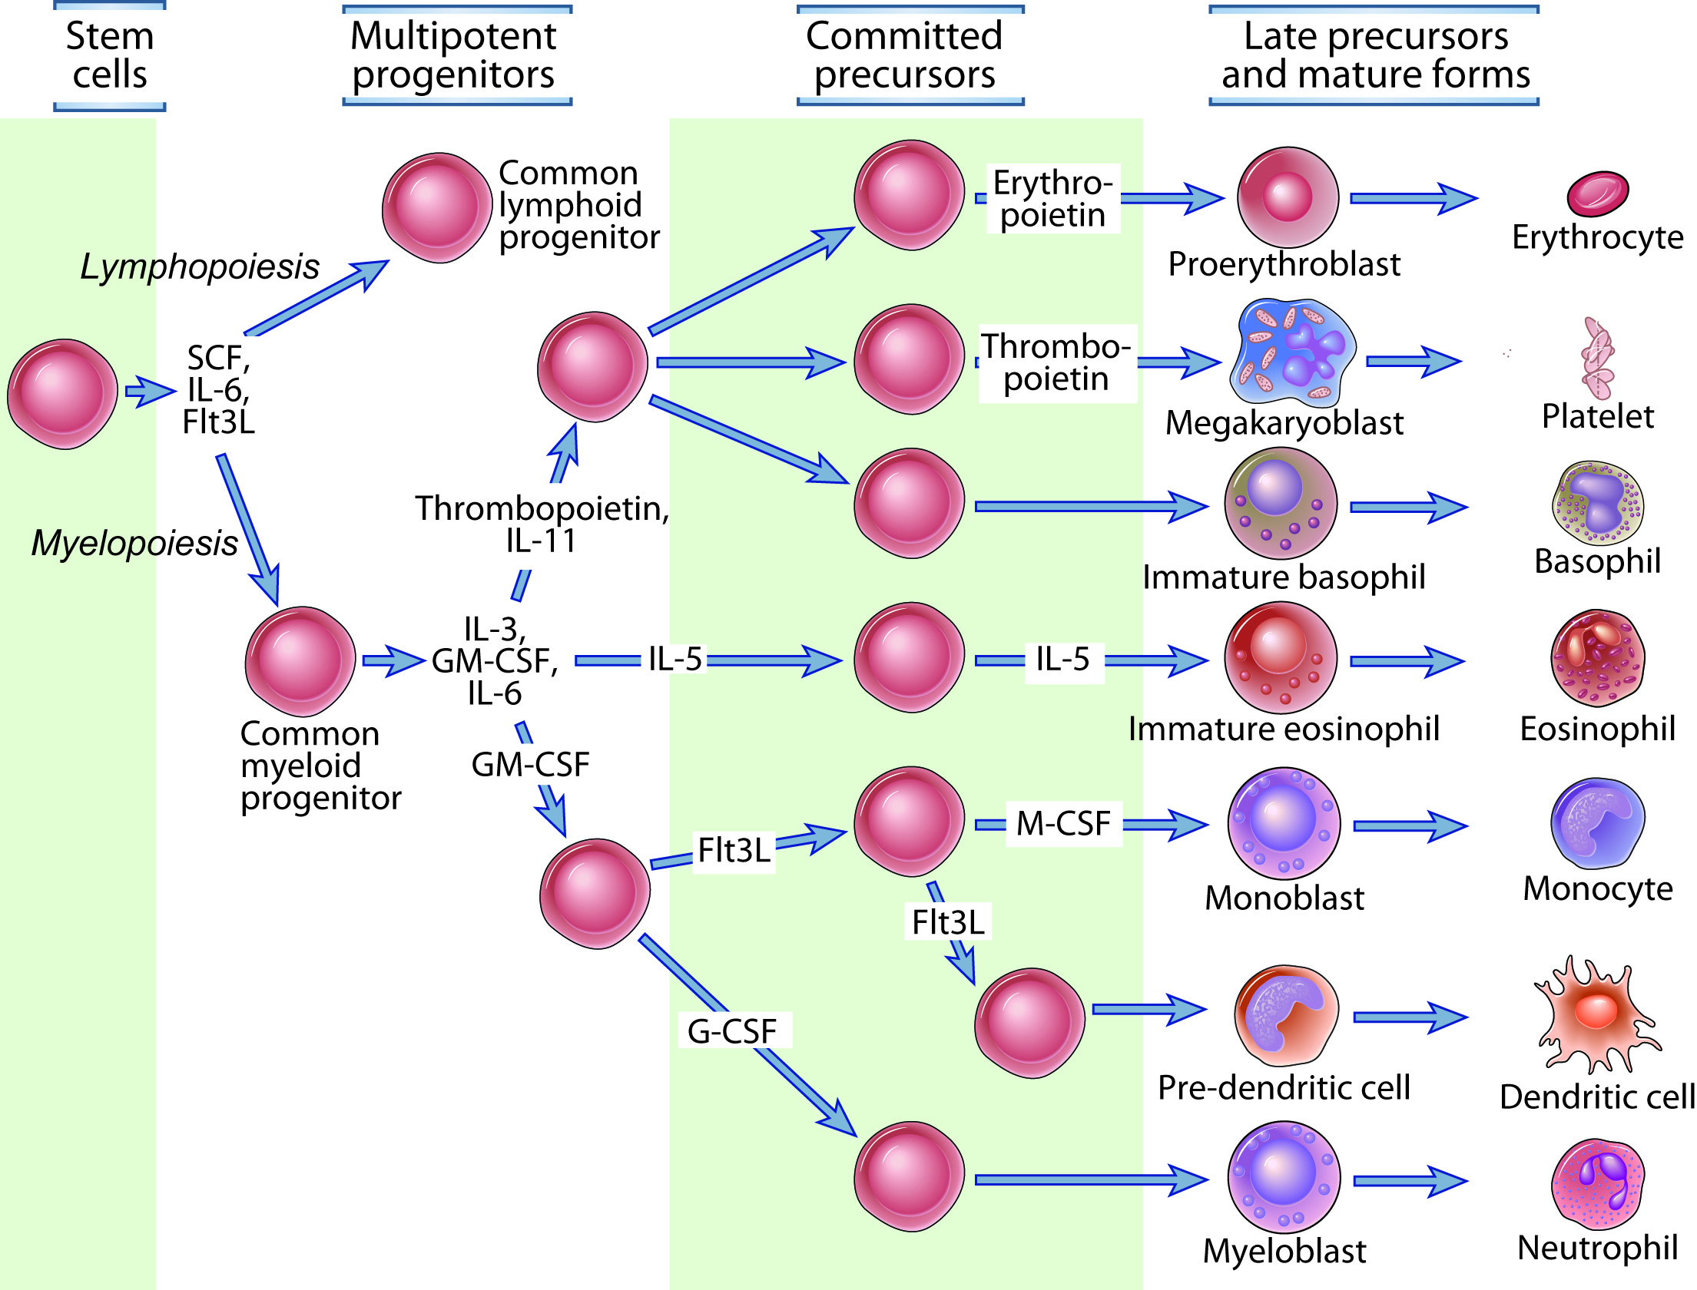
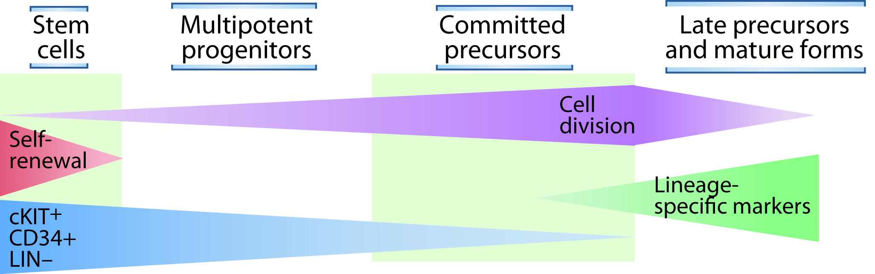
TT & B lymphocytes…..maturation, specificity…….
HEMATOPOIESIS
Fig. 2-9

Slide 11
Cells of the immune system
plasma cell
T- lymphocyte B- lymphocyte natural killer cells
lymphoid progenitor
STEM CELL
myeloid progenitor
Mast cells basophil eosinophil neutophil monocyte megakaryocyte

Slide 12
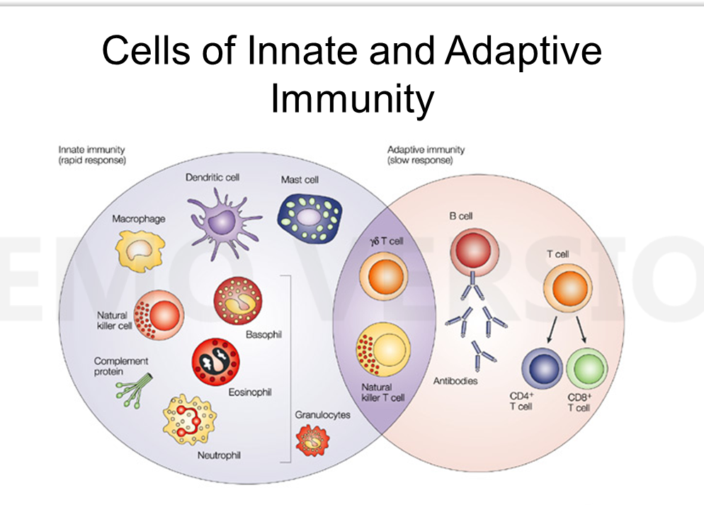
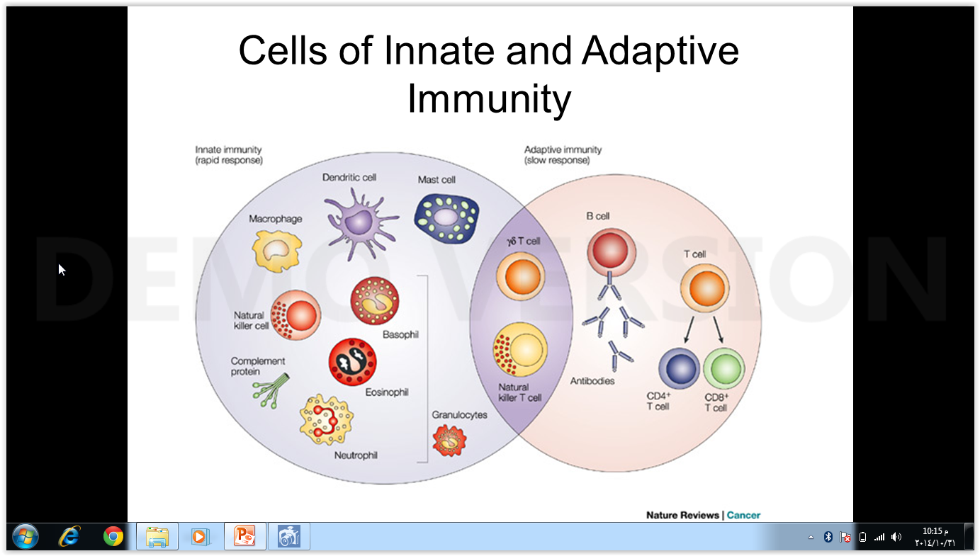

Slide 13
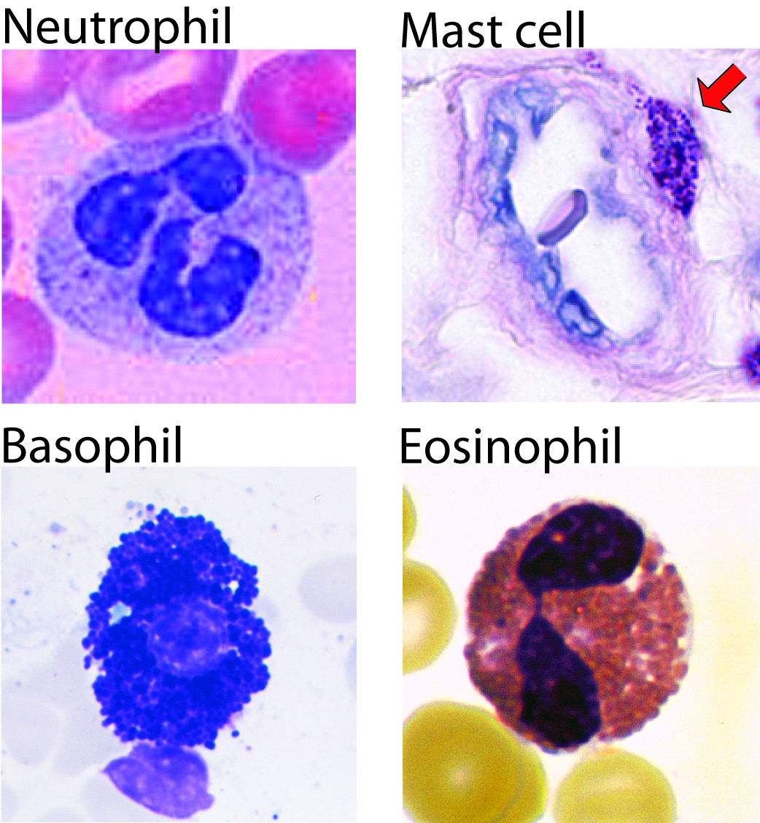
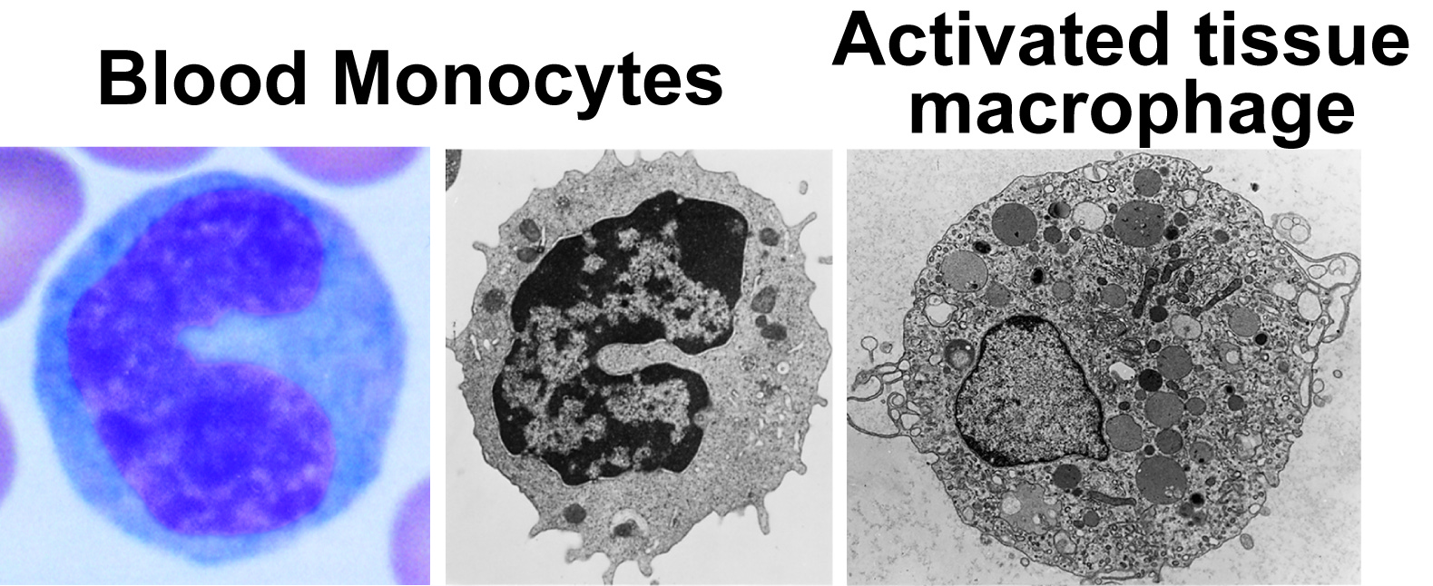
The non-lymphoid players:
Some participate in the induction phase and the effector phase, some only as immune response effectors

Slide 14
Lymphoid cells
adult)) - Lymphocytes 20% of W .B.CS
- Mature lymphoid cells long lived for many years
as memory cells
The mononuclear cells are heterogenous in size & morphology
The typical small lymphocytes are agranular & comprise T- lymphocyte
B- lymphocyte

Slide 15
- The large cells ( large granular lymphocytes)
Contain cytoplasmic granules
Cells which able to kill certain tumor & virally infected cell natural killing & destroy cells coated with immunoglobulin
( mediated antibody – dependent cell – cytotoxicity)

Slide 16
Myeloid cells
The second pathway of development
Mononuclear phagocytes polymorphonuclear leucocytes
The common myleoid progenitor monocytes blood tissues macrophages (life span months to years)
The human blood monocyte is larger than a lymphocyte & has a kidney shape nucleus

Slide 17
This actively phagocytic cell has an ruffled
membrane & many cytoplasmic granules
These lysosomes contains :
Enzymes molecules that are involved in the killing of M.O

Slide 18
Mononuclear phagocytes adhere strongly to
surface & have various cell membrane
receptors to aid the binding & ingestion of
foreign material

Slide 19
Their activities can be enhanced by molecule produced
by T-lymphocytes called lymphokines
Monocytes & macrophages
Complement prostaglandins interferons
such as interleukin Monokines
tumor necrosis factor
Lymphokines & monokines cytokines

Slide 20
Cells of the immune system
Type of immunity | Morphological definition | Developmental lineage | Cell type
innate | Polymorphonuclear | myeloid | neutrophils
innate | polymorphonuclear | myeloid | eosinophils
innate | polymorphonuclear | myeloid | basophils
innate | polymorphonuclear | myeloid | Mast cells
innate | mononuclear | myeloid | Monocytes - macrophages
innate | mononuclear | lymphoid | Natural killer cells
adaptive | mononuclear | lymphoid | Cytotoxic T -lymphocytes
adaptive | mononuclear | lymphoid | Helper T- lymphocytes
adaptive | mononuclear | lymphoid | B - lymphocytes

Slide 21
Polymorphonuclear lymphocytes granulocytes
2-3 days life span
- divided acc. To histochemical staining :

Slide 22
1- neutrophils ( microphages) multilobed nucleus:
- most abundant circulating granulocytes
- smaller than macrophages
- migerate to site of infection ( chemotaxis )
i,e the cells enter the tissues when a chemotactic produced due to infection or injury
- posses phagocytic activity
- produce inflammatory mediators such as prostaglandins
& immune mediators such as interleukins

Slide 23
Chemical mediators
Inflammatory mediators immune mediators
Produced by Produced by
Phagocytic & mast cells monocytes lymphocytes
Prostaglandins histamine monokins
lymphokins

Slide 24
2- eosinophil ( acidophil)
Less efficient than neutrophils
- 1-2% of leucocytes
- increase in allergic conditions
- somewhat phagocytic
- their major function by producing cytotoxic molecules in granule content can kill parasites that are too large to be phagocytosed

Slide 25
3- basophils
Less than 0.2% of leucocytes
- release pharmacological mediators
Such as histamine ( which responsible for allergic reaction)

Slide 26
4- monocytes ( macrophages)
Monocytes circulate in blood for 3 days , then migerate to tissues & change to macrophages
- migerate to site of infection ( chemotaxis)
- posses high phagocytic activity
- produce inflammatory & immune mediators
- digestion of microorganism

Slide 27
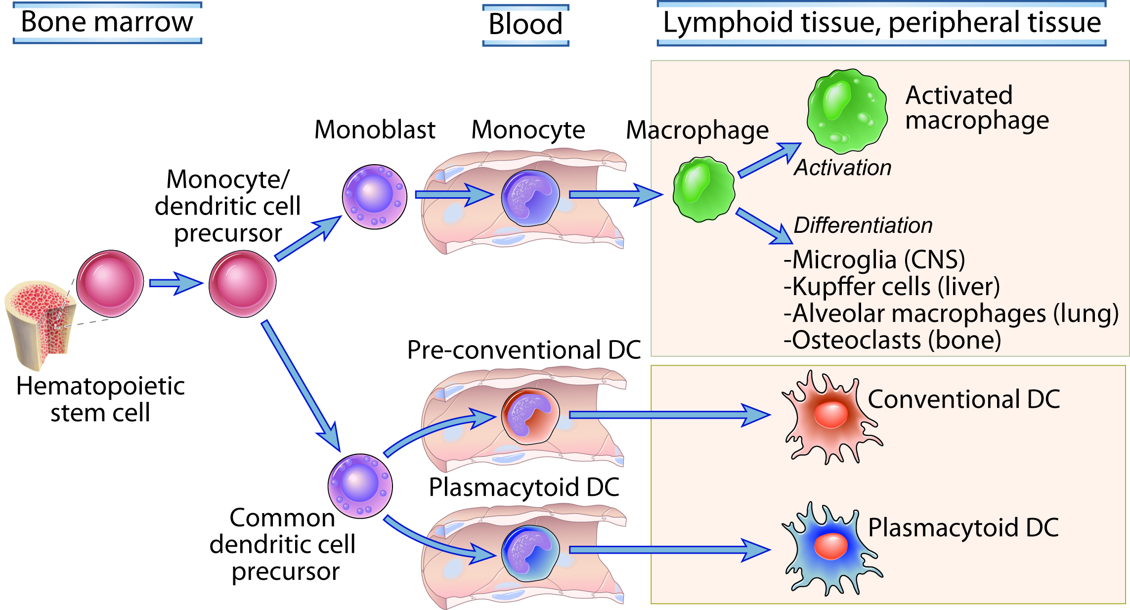
These mononuclear phagocytes are derived from a common precursor in the bone marrow, then differentiate to monocytes or dendritic precursors, circulate in the blood, and mature further depending on environmental cues

Slide 28
5- natural killer cells ( NK cells)
Kill tumor cells & virus infected cells
- non specific
just destroy any cell that can develop tumor
-they are called natural killer cells because the cells kill without the need of antigen –specific activation but enhanced by exposure to certain cytokines ( interferons) produced by virus infected cells

Slide 29
6- killer cells ( K cells)
-more specific
They kill antibody – coated target cells
- mediate antibody –dependant cellular cytotoxicity
ADCC
MECHANISM OF KILLING:
PERFORINS – GRANZYMES - APOPTOSIS

Slide 30
7- LYMPHOCYTES
There are 2 main subsets B & T lymphocytes
T-lymphocytes | B-lymphocytes
Named after thymus gland on which their maturation depends | Named after Bursa of fabricius in chickens In human, bone marrow, peyer patches & appendix
Constitute 70% of total lymphocytes | Constitute 30% of total lymphocytes
Of long lifespan ( months or years ) Memory cells | Of short lifespan ( days or weeks)
Upon stimulation, they differentiate into effector T-cells, some produce lymphokins, some cytotoxic & other can be helper cells | Upon stimulation , they differentiate to plasma cells producing specific antibody or immunoglobulins

Slide 31
immunity
Immunity provides
protection against organisms,
the functions of the immune system are recognition of these foreign pathogens and
defence of the body against them
Defence is mediated by a range of innate & adaptive cells & molecules that stimulate inflammation & cause digestion or lysis of foreign pathogens or infected cells

Slide 32
Antigens ( immunogens)
They are substances capable of stimulating a specific immune response
simple or compound nitrogenous substance-
:

Slide 33
_ in order to be antigenic ,
the substance must fullfil certain conditions

Slide 34
1- foreignness:
Immune system recognize ( self antigens) does not get
activated against them
_ more foreignness the substance has the more powerful antigenic it will be

Slide 35
2- molecular size
Substance with molecular weight over 100,000 daltons are antigenic
Around 10,000 are weak ones
Monosaccharides & amino acids are not immunogenic ,
while protein & polysaccharides?????? are immunogenic

Slide 36
3- specificity
Strong antigens are large molecules, however only a restricted portions of them , are involved in the actual binding with the antibodies
- antigenic determinants ( epitopes) determine the specifity of the antigen

Slide 37
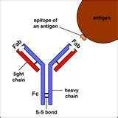

Slide 38
4- chemical complexity
Molecules must posses certain degree of chemical complexity in order to be antigenic-

Slide 39
5- others
Route of adminstration
- presence of adjuvant stimulate immune response better

Slide 40
Antigenic types
1- heterologous antigen :
Present in different animals & different tissues
Ag derived from one species & can stimulate response in another species
e.g insulin that was produced from pig used by human to treat diabetes

Slide 41
2- homologous antigen :
Where specific antigen react with specific antibody

Slide 42
3- auto antigen :
It is a self antigen ( normal constituent of the body tissue ) no immune response is formed against them

Slide 43
4- iso antigen :
Present in R.b.Cs & responsible for blood grouping

Slide 44
5- forsman antigen :
Present in G.pigs tissues & R.B.Cs
Also in human , rats, dogs but absent in cows, rabbits & pigs
Have the ability to react with different antibodies in the same animal tissues

Slide 45
Antigenic structure
hapten | immunogens
fats CHO others | Protein A.A Mucopeptides | Chemical structure
Able to react with antibodies Unable to stimulate their production directly | Able to stimulate an immune response & production of antibodies
Less than 5000 daltons | high | Molecular weight
Responsible for specification of antibodies | Responsible for stimulation

Slide 46
Epitope:
-Small part of an antigen that interacts with an antibody. 10-12 amino acids
-Any given antigen may have several epitopes.
-Each epitope is recognized by a different antibody.

Slide 47
Bacterial antigens
There 5 bacterial antigens :
1- somatic Ag ( O) :
In cell wall & cytoplasm
Protein in nature
Heat resist
Formaline sensitive
Alcohol or phenol resist

Slide 48
Flagellar antigen (H)
Flagellin ( protein in nature)
Heat sensitive at 60 -80 °c
Alchol & phenol sensitive
Formaline resist

Slide 49
3- capsular antigen (K)
Polysaccharides, mucopeptides, polypeptides
Heat resist
Present in capsulated bacteria only
Surface antigen (S):
Polysaccharides
Present in streptococci , E.coli, pasteurella

Slide 50
4- virulence antigen (Vi)
Freshly cultivated) ) Characteristic for diphetria bacilli
Simillar to surface antigen
Repeated cultivation the virulence disappear (salmonella bacilli )

Slide 51
5- spore antigen
In sporulated bacteria only

Slide 52
Immunoglobulins ( antibodies)
General characters:
1- glycoprotein
2- present in serum & body fluids
3- induced when immunogenic molecules are introduced into the host’s lymphoid system
4- reactive with, and bind specifically to, the antigen that induced their formation

Slide 53
5- All immunoglobulin molecules have a common structure of 4 polypeptide chains
2 large or heavy chains
2 small or light chains
6- There are 5 classes of human immunoglobulins
7- The difference between them depending on their heavy chains and called isotypes

Slide 54
8- Ig heavy chains are designated
IgG gamma Y chains
chains µ IgM mu
chains α IgA alpha
chains Є IgE Epsilon
chains δ IgD delta

Slide 55
9- Light chains
κ Kappa
Lambda λ

Slide 56
How Do B Cells Produce Antibodies
?
  B cells develop from stem cells in the bone marrow of adults (liver of fetuses).
  After maturation B cells migrate to lymphoid organs (lymph node or spleen).
  Clonal Selection: When a B cell encounters an antigen it recognizes, it is stimulated and divides into many clones called plasma cells, which actively secrete antibodies.
  Each B cell produces antibodies that will recognize only one antigenic determinant.

Slide 57
Antibody structure

Slide 58
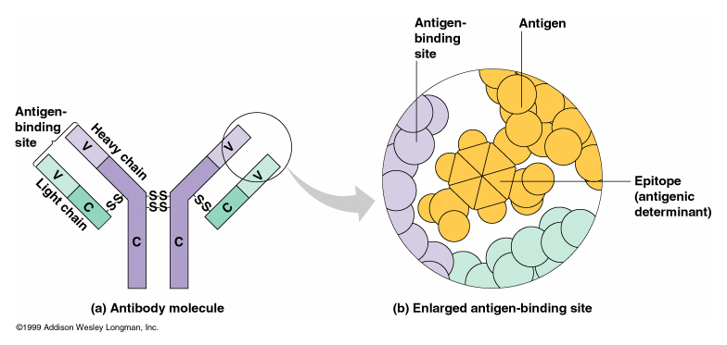
Antibody Structure

Slide 59
Heavy Chain – 110 amino acids long
100 distinct V segments
30 D segments
6 J segments
Enzymes choose one V segment, one D segment and one J segment and fuse them together
18,000 combinations in encoding antibody molecule this variable region to the constant region

Slide 60
Light Chain – 211 amino acids long
10,000 combinations
Total of 180,000,000 distinct B cells
Fusion is sloppy, can create other variants

Slide 61
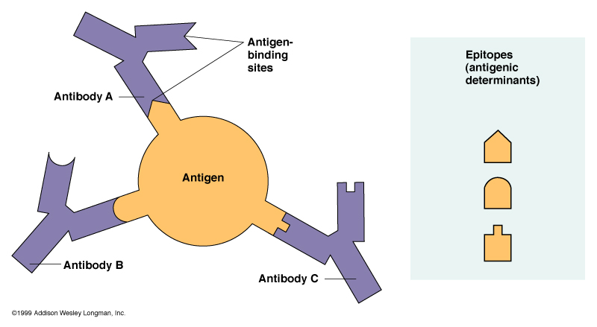
Epitopes: Antigen Regions that Interact with Antibodies

Slide 62
Ig G
The major immunoglobulin of serum 75%
- molecular weight is 150000 in humans
- the secondary response antibody
- 4 subclasses are found IgG1 , IgG2, IgG3, IgG4
Differed in:
their concentrations ,
aminoacid composition ,
Number & position of disulphide bonds
Biological functions

Slide 63
IgA
Most of the serum IgA occurs as a monomer, but in many other mammals found as dimer
The dimer is held together by J chain
J chain
Dimeric chain

Slide 64
Produced by the antibody producing plasma cells
- Ig A is the predominant antibody class in seromucous secretions such as saliva , tears, clostroum, respiratory, gastrointestinal & genitourinary secretions
- it facilitates passage through the epithelial cells & protects the secreted molecule from proteolytic digestion
- there are 2 subclasses of Ig A ( IgA 1 , Ig A2 )

Slide 65
Ig M
Is a pentamer of the basic unit with a µ heavy chain & a single J chain
- is the first antibody type to be produced during an immune response

Slide 66
Ig D
Many circulating B cells have Ig D present on their surface
- less than 1% of the circulating antibody
- have a short half- life in serum because the protein is very susceptible to proteolytic attack

Slide 67
Ig E
- Is present in extremely low levels in the serum
- It found on the surface of the mast cells & basophils

Slide 68
The immune system is split into 2 functional divisions:
Innate immunity acquired or adaptive
natural or native the first line of defence specific response against infectious agents to each infectious agent

Slide 69
Innate immunity
All multicellular organisms contain intrinsic mechanisms of defence against infections, which constitute innate immunity
The mechanism of innate immunity respond to microbes & not to non microbial substances
Are specific for structures present on various classes of microbes
- are mediated by receptors encoded in the germ line
- are not enhanced by repeat exposure to microbes

Slide 70
The principle components of innate immunity
1- epithelia :
provide physical barriers against microbes, produce antibiotics & contain lymphocytes that may prevent infections

Slide 71
2- the principle phagocytes, neutrophils & monocytes – macrophages are blood cells that are recruited to sites of infection
Neutrophils & macrophages recognize microbes by several receptors, ingest the microbes, secrete cytokines ( elimination of microbes & repair of infected tissues )

Slide 72
3- natural killer cells NK cells :
Kill host cells infected by intracellular microbes & produce the cytokine which activates macrophages to kill phagocytosed microbes

Slide 73
4- the complement system :
Is a family of proteins that are activated sequentialluy on encounter with some microbes & by antibodies ( in the humoral arm of adaptive immunity )
Complement proteins coat ( opsonize) microbes for phagocytosis, stimulate inflammation, & lyse microbes

Slide 74
5- cytokines of innate immunity function to :
- Stimulate inflammation
- Activate NK cells
- Activate macrophages
- Prevent viral infections

Slide 75
Adaptive immunity

Slide 76
Cell mediated immunity
T – lymphocytes are the cells of cell mediated immunity,
Cell mediated immunity is the arm of the adaptive
Immunity
That combats intracellular microbes which are ingested by phagocytes & live within these cells or microbes that infect non-phagocytic cells

Slide 77
The responses of T-lymphocytes consist of squential phases :
1- recognition of cell associated microbes by naive
T-cells
2- expansion of the antigen specific clones by proliferation
3- differentiation of some of the progeny into effector cells & memory cells

Slide 78
When help arrives . . .
The T-helper cell receptor “docks” with the B cell’s MHComplex
B cells proliferate . . .
Antigen & T-helper cell
Naïve cell
Proliferation of cell line

Slide 79
B cells differentiate into . . .
  Antibody producing cells [attack mode]
  Memory cells [remembers & future protection]
Antigen & T-helper cell
antibodies
memory

Slide 80
Types of cell mediated immunity
There are 2 types of cell mediated immune reactions:
CD4+ helper T cells
CD8+ cytotoxic T lymphocytes CTLs

Slide 81
CD4+ Helper T Cells :
Activate phagocytes to destroy microbes residing in the vesicles of these phagocytes
CD4+ Cells + microbes cytokine secretion
inflammation macrophage activation , killing of ingested microbes
CD8+ T lymphocytes cells :
Kill any cell containing microbs or microbial proteins in the cytoplasm , thereby eliminating the reservoir of infection

Slide 82
Humoral immune response
Humoral immunity is mediated by antibodies
The arm of the adaptive immune response
That neutralize & eliminate extracellular microbes & microbial toxins

Slide 83
Humoral immunity is more important than cellular immunity in defending against microbes with capsules rich in polysaccharides & lipids, & against polysaccharides & lipid toxins .
The reason for this is :
B cells respond to& produce antibodies specific for many types of molecules but T cells , the mediators of cellular immunity recognize & respond only to protein antigens

Slide 84
Hypersensitivity
Def:
Excessive or inappropriate response to an antigenic stimulus ( bacteria, protein, hapten, serum or some drugs) previously the body infected with them.
harmful to the host
This reaction is rapid or slow after allergy

Slide 85
There are 4 types of hypersensitivity
1- anaphylactic :
If a G.pig is injected with a small dose of an antigen ( egg albumin) no adverse effects are noted
If a second injection of the same antigen is given intravenously after an interval of about 2 weeks
Symptoms : asthma leads to death
Ig E produced in this case
A condition known as anaphylactic

Slide 86
Mechanism
Antigen stimulates formation of AB ( IgE)
- IgE fixes, by its Fc portion to mast cells and
basophiles ( cell bound IgE)
Re-exposure to the same sensitizing antigen ( allergen), it cross – links the Fab portion of mast cells and release of preformed mediators ( Immediate phase): within minutes, vasodilatation …….., ready preformed mediators (histamine)
Cytokines produced by mast cells ( TNF, IL-4& IL5) stimulate the recruitment of leukocytes, which cause the late phase reaction ( 6hours after exposure, erythema, edema……..broncospasm . Mediators ( leukotriens).-

Slide 87
2- type II : cytotoxic
Type II reactions are initiated by the binding of an antibody ( IgM & IgG )to an antigenic component on a cell surface ( drug , microbial product passively absorbed onto a cell surface)
The cell that is covered with antibody is then destroyed by the immune system
Ex.: salmonella & mycobacteria are associated with haemolytic anaemia
Due to an immune reaction against a lipopolysaccharide bacterial endotoxin that coated onto erythrocytes of the patient anaemia

Slide 88
Mechanism
Activation of complement
Phagocytosis : mediated by opsonins on cells which detected by receptors on phagocytes
ADCC by Nk

Slide 89
3- type III : immune complex
Sometimes , antibodies ( IgM & IgG ) against soluble antigens may form complexes with the antigens & the immune complexes may deposit in blood vessels in various tissues , causing inflammation &
tissue injury
Such diseases are called immune complex diseases
& represent type III hypersensitivity
For example : Pencillin & sulphonamides for susceptible patients

Slide 90
Type IV cell mediated or delayed
Cell mediated hypersensitivity are seen in a number of chronic diseases due to mycobacteria, protozoa &
fungi
Because the host is unable to elimenate the micro-organism the antigens persist & give rise to a chronic antigenic stimulus.
Continual release of lymphokines from sensitized T – lymphocyte cells ( Th & Tc)results in the accumulation of large numbers of activated macrophages
These cells can fuse together to form giant cells
Leads to tissue damage with the formation of a chronic granuloma cell death

